Slide 1
Sales Analysis for Automobile Company
Name: Adit Deshpande
Student No: 10505324
Name: Ali Asgar
Student No: 10532445 Name: Natraj
Student No: 10534918

Slide 2
Dataset
The Dataset has Sales Details of an Automobile Company that deals with large scale vehicles to various other Companies.
The Company is a Fleet management company which means buying and selling a large number of Vehicles.
The process includes Customers, Vendors, Employees who sell the Vehicles.
The Requirement for this analysis is mainly the number of Sales by Employee and Country to analyze the Revenue Generated and understand Customer buying behavior.

Slide 3
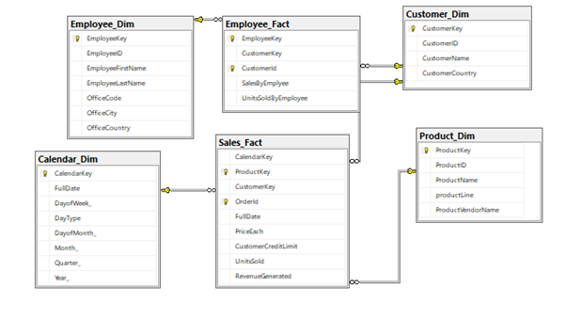
Schema
Employee_Dim: Displays Employee Details
Cusotmer_Dim: Displays Customer Info.
Calendar_Dim: Displays Timeline of Dataset
Product_Dim: Displays a list of Product and Vendor name.
Sales_Fact: Displays information related to Sales
Employee_Fact: Displays information related to Employees

Slide 4
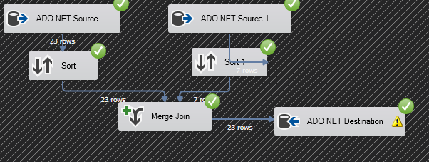
ETL Process 1:Employee_Dim
In this ETL process, the data loaded into Employee_Dim table using dataset. Here, Data from two tables employees and offices are sorted and joined to the destination.

Slide 5

ETL Process 2: Customer_Dim
In this ETL process, the data is loaded into Customer_Dim from the table customers.

Slide 6
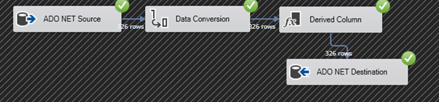
ETL Process 3: Calendar_Dim
In this ETL process, the data is loaded into Calendar_Dim using ordered Date field of orders table, the data type of field is converted to match the columns in the Dimension table. Some columns are derived using order Date and loaded in Calendar_Dim.

Slide 7

ETL Process 4: Product_Dim
In this ETL process, the data is loaded in Product_Dim from the table products.
In this ETL process, the data is loaded in Product_Dim from the table products.

Slide 8
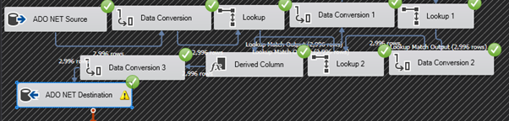
ETL Process 5: Sales_Fact
In this ETL process, data from Calendar_Dim, Customer_Dim and Product_Dim are loaded in Sales_Fact using look up and Data Conversion. Lookup is used to extract the data from the source dimension and pass it to the destination fact.
In this ETL process, data from Calendar_Dim, Customer_Dim, and Product_Dim are loaded in Sales Fact using lookup and Data Conversion. Lookup is used to extract the data from the source dimension and pass it to the destination fact.

Slide 9
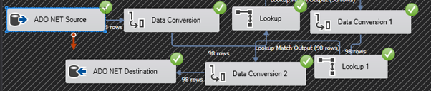
ETL Process 6: Employee_Fact
In this ETL process, data from Cutomer_Dim and Employee_Dim are loaded in Employee_fact using lookup and Data Conversion. Lookup is used to extract the data from the source dimension and pass it to the destination fact.

Slide 10
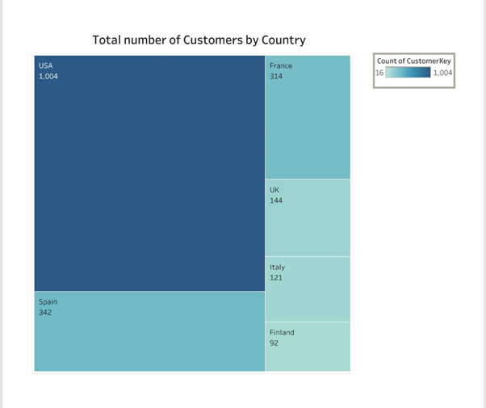
Visualization 1
In this Visualization, we are visualizing the Total number of Customers by Country. As most of our customers are from the USA and Europe that is the reason we have used Treemap to understand the count of the Customers in a particular Country.

Slide 11
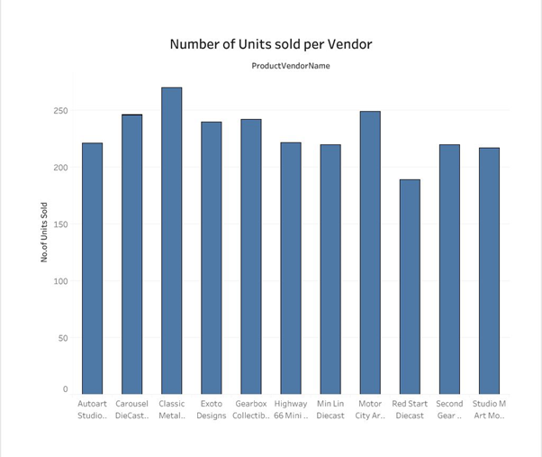
Visualization 2
This is the Visualization for the Number of Units sold per Vendor. The graph gives a clear idea about the Vendor who sold the maximum units.

Slide 12
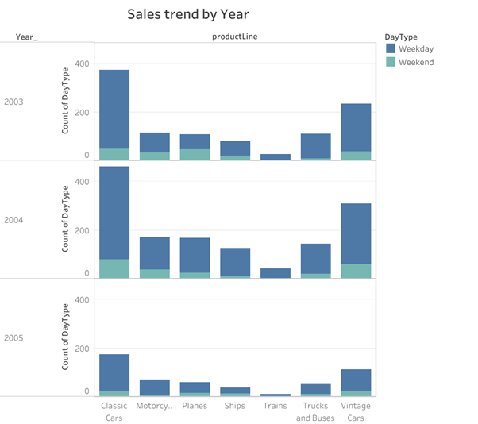
Visualization 3
The graph shows the Sales trend by Weekday or Weekend. By this graph, we can see that most of the sales are happening on the Weekday. Also, Cars are mostly bought by the customers on Weekday and Plane on the weekends. This analysis can be used for marketing purposes as well.

Slide 13
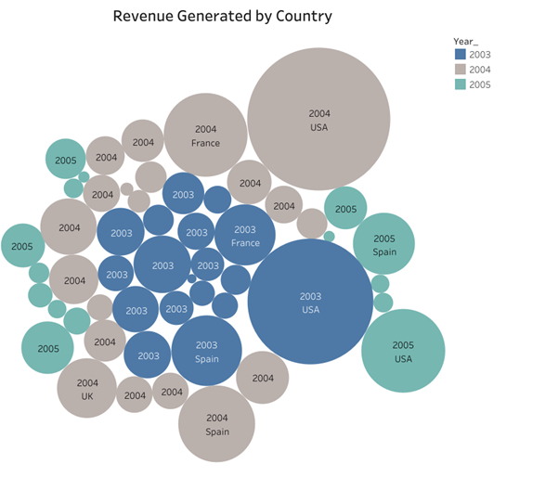
Visualization 4
This Visual is about the Revenue Generated by Country. A Bubble graph is used in this Visual. The Bigger Bubbles show the name of the and year which has generated the maximum revenue, Similarly, the smaller bubbles show the minimum revenue.

Slide 14
Relational DB vs Graph DB
Relational
Tables
Schema with Nullables
Relation with Foreign Keys
Queries with Joins are sometime slow
Highly Structured Data
Graph
Nodes
No Schema
Relation is First Class Citizen
Faster Queries
Semi Structured Data with relationships

Slide 15
How Graph Database Stores Data?
Native Database essentially store the data into two different pieces.
Nodes Store the information about the various entities in the system while Relationships store information about the relationships that connect the node.
Nodes also store the “id’s” if the nodes and relationships that each node is involved in and each relationships stores the source and destination node.

Slide 16
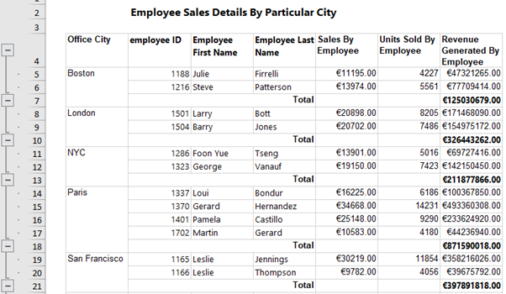
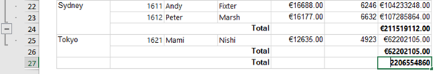
SSRS Report 1
This is an SSRS Report for Sales Analysis and it shows sales by city. From this analysis, we can observe that Paris has done the most sales compared to all the cities. Tokyo has done good sales compared to the number of employees in the city. If the number of employees is increased in Tokyo then there is a good chance of Generating more Revenue.

Slide 17
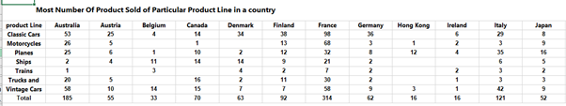
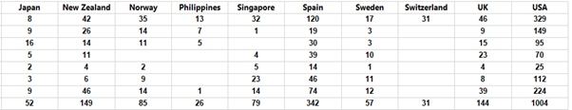
SSRS Report 2
This report is of Sales of Product from different ProductLine in Different countries. With the help of this report, we can analyze the less popular Product in a particular country and can try to promote less popular products.
For Example, Hong Kong is a tourist place and also has a coastal area, Considering this product like Ship and Classic Cars can be promoted to boost sales.

Slide 18
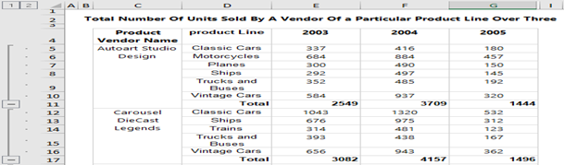
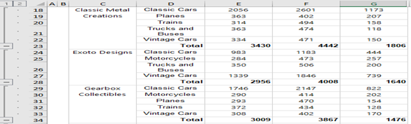
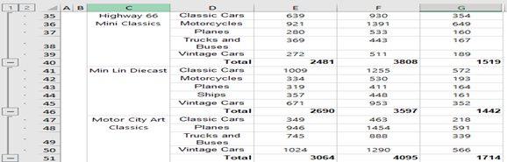
SSRS Report 3
This Report shows the number of units sold by each Vendor to the company over a period of 3 years from the year 2003 to 2005.

Slide 19
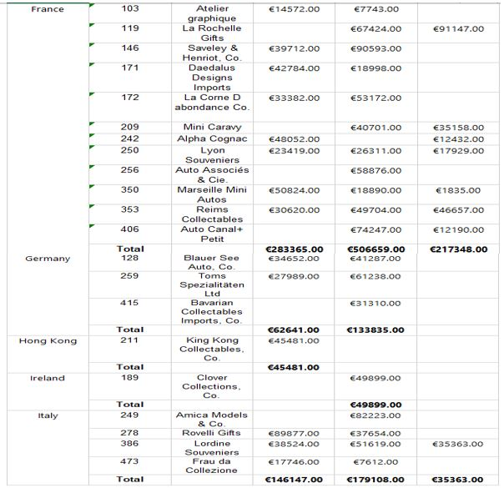
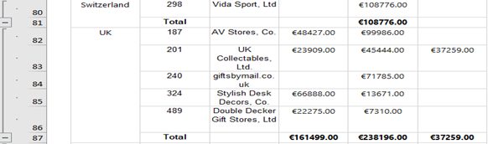
SSRS Report 4
This report shows information about customer's sales in different countries. From the report we can see that in some countries the company has only one customer. The Company can look at this situation as an opportunity to develop more business in countries like Hong Kong, Ireland, Switzerland, etc.

Slide 20
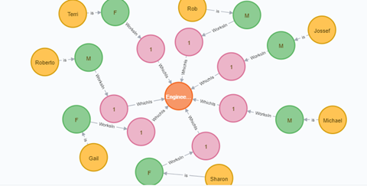
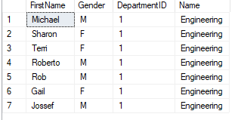
Graph Database 1
This Graph shows the Employee categorized into Male and Female who works in the Engineering Department. There are two nodes that are from the Department table and one node from the Person table.

Slide 21
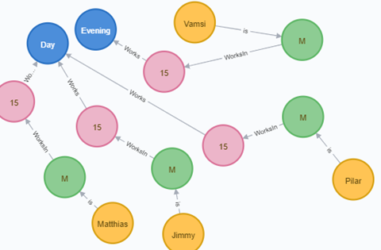
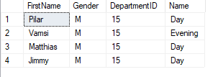
Graph 2
This Graph shows shifts in Male employees whose DepartmentID is 15. It is very clear from the Graph that 3 of the employees do Day shift and one employee does evening shift.

Slide 22
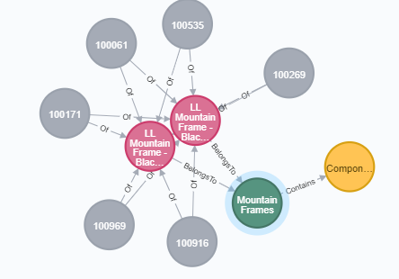
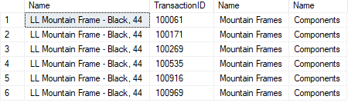
Graph 3
This Graph Shows Transaction History of a Product’s Category and Subcategory. The grey node has TransactionID of Name LL Mountain Frame Black which belongs to Sub Category Mountain Frames and Category Components.

Slide 23
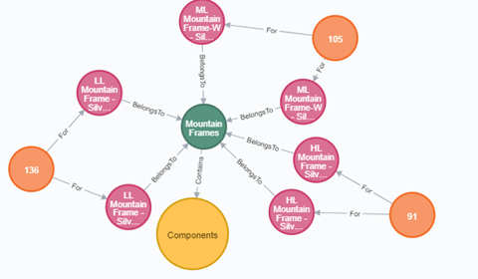

Graph 4
The above graph shows the Category, Sub Category, and Name of the Product with the Quantity. Mountain Frames is a Category that has LL Mountain Frame Silver as Sub Category of Product Component and the Quantity of those products are in the outer nodes. The Relationship gives a clear idea of Category and Subcategory.

Slide 24
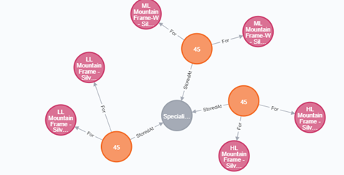

Graph 5
This Graph shows the Category of Products and the location at which they are stored. For the above graph “LL Mountain Frame Silver” is stored at Location ID “45” which is “Specialized Paint”.

Slide 25
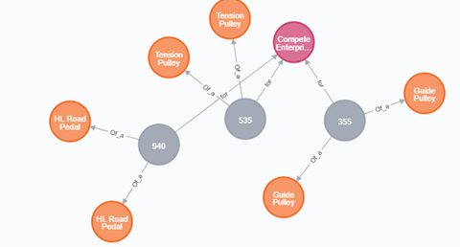

Graph 6
The above graph is a relationship about an order for the Purchasing Vendor Complete Enterprise. “Guide Pulley” of Product ID “355” has ordered by the company “Compete Enterprise”.

Slide 26
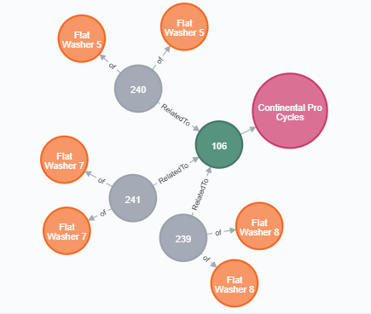

Graph 7
The graph shows and order placed by a vendor. The difference between the previous graph and this graph is that in this particular graph there is two Product ID. One is a ProductOrderDetailID and the other is ProductOrderID which is like an ID of an ID. For Example, For the order of “Flat Washer 7” of Order Detail ID “241” which is related to Order ID “106” was placed by the Purchasing Vendor “Continental Pro Cycles”.

Slide 27
Thank You

